Slide 1
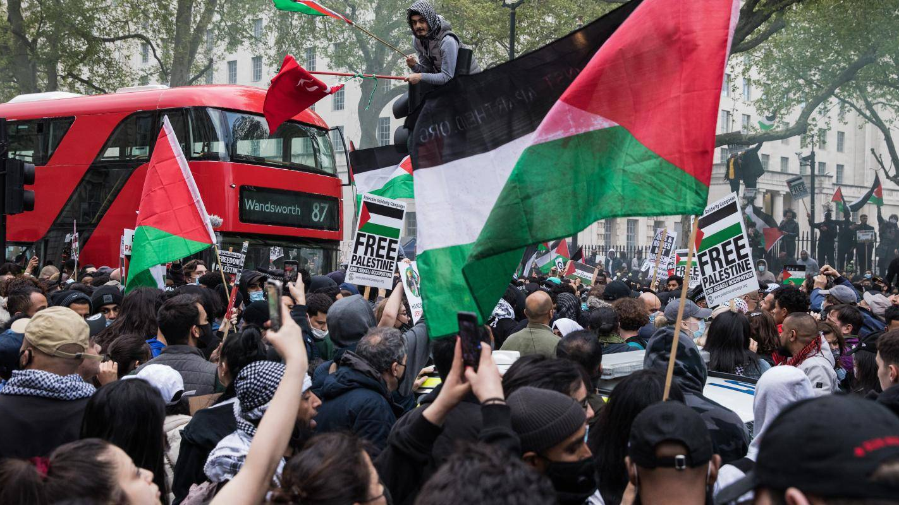
Palestinian – Israel Conflict 2000 – 2023
Analysis
By Amish Ilyas

Slide 2
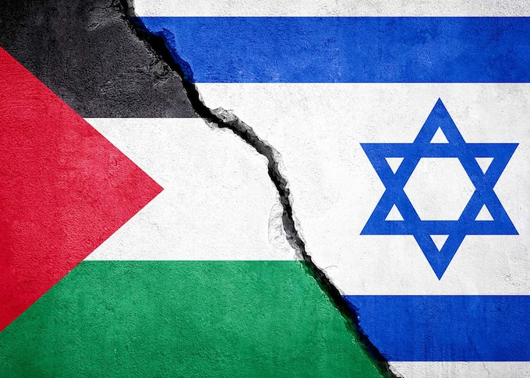
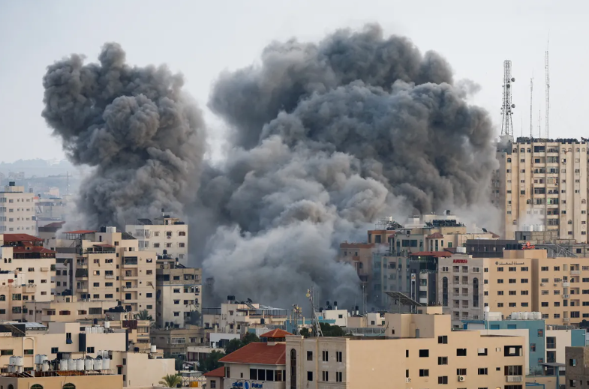
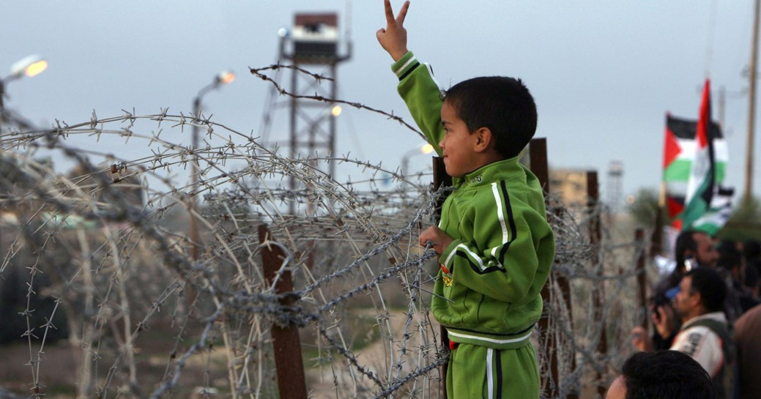
Agenda
Introduction
Problem Statement and Tools
Trends and Insights

Slide 3
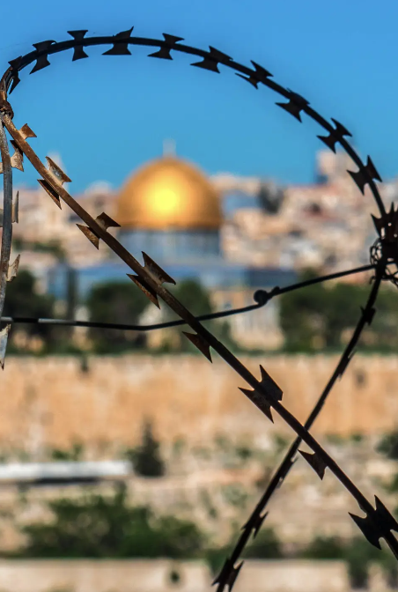
Introduction
The Israeli-Palestinian conflict is a long-standing struggle over land, sovereignty, and political rights, primarily centered around issues like the status of Jerusalem, territorial borders, and the displacement of Palestinians. Since the Second Intifada in 2000, the conflict has caused thousands of deaths, including civilians and children.
This analysis explores patterns in the fatalities to better understand the human impact of the conflict — highlighting who was affected, where, and under what conditions.

Slide 4
Problem Statement
Analyze the Israeli-Palestinian conflict fatalities since 2000 to identify patterns and trends across time, demographics, geography, causes of death, and ammunition used, with a special focus on civilian and child casualties

Slide 5
As the Conflict Begin in 2000 35 People Died. Fatalities peaked in 2014 with 2299 deaths, followed by a significant drop in 2015. Till Now While September has least Deaths 436 and July has Most No of Deaths 2149
Total Deaths
10969

Slide 6
87.40 Percent were Male Target and 12.60% were Female Targets That Were Killed In Conflict .Male are more Prone to Killing Because of The conflict participation.

Slide 7
Death Is Mostly in Range of 21-30 Age . 4079 Males and 257 Females. Because Maybe They Participate in Conflicts more . Female have Died Mostly in age Range 11-20Age 297 Died. 60+ People have died least

Slide 8
Most of The Deaths Causes are Unknown but Missile is The Most used Weapon or Technique in Killing during conflicts with 2859 Deaths

Slide 9
Deaths By Location Region Clearly Shows that Most of The Killing has done in Gaza 7651 Killed West Bank 2654 and Israel 664

Slide 10
Most of The People that were Killed in the Conflict are Poor Palestinain 9957 then 1109 Israeli 2 Jordanian and 1 American

Slide 11
89.96% are Killed By Israeli security forces with the help of weapons . 9.19% Palestinian civilians and 0.85% by Israeli civilians

Slide 12

Conclusion
This is a critical Matter that is even happening in 2025 . World has to wake up to resolve this matter . Analysis shows that most of the Killing is done to Innocent Palestanians those who have no weapons by the Brutal Armed Forces of Israel . It’s not a matter of race or one religion it’s the matter of lives .That Needs to be Stopped Wake Up World !

Slide 13
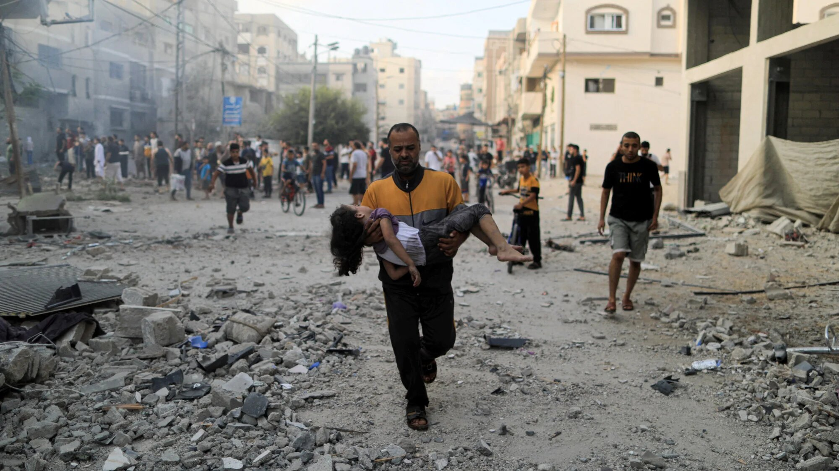
Thank you
Amish Ilyas
ilyasamish@gmail.com

